Slide 1








loyee Data Analysis using Excel
STUDENT NAME: BALAJI.S
REGISTER NO.312203230,asunm161312203230
DEPATMENT:B.COM, COMMERCE
COLLEGE: PRINCE SHRI VENKATESHWAR ART'S AND SCIENCE COLLEGE
1

Slide 2


PROJECT TITLE
Creating an employee performance scoreboard in Excel using pivot tables for employees turnover analysis
2

Slide 3



AGENDA
1.Problem Statement 2.Project Overview 3.End Users 4.Our Solution and
Proposition
5.Dataset Description 6.Modelling Approach 7.Results and Discussion 8. Conclusion
3

Slide 4



PROBLEM STATEMENT
Employee performance evaluations are conducted to:
1. Measure job performance. 2. Provide feedback and development. 3. Align goals with company objectives. 4. Inform compensation decisions. 5. Motivate employees. 6. Offer legal protection. 7. Aid in succession planning. 8. Identify training.
4

Slide 5


PROJECT OVERVIEW
Employee performance refers to how well an employee fulfills their job duties and contributes to organizational goals. It involves measuring productivity, quality of work, efficiency, and overall contribution. Evaluating employee performance helps identify strengths and areas for improvement, guides development and training, informs compensation decisions, and ensures alignment with company objectives. Effective performance management leads to motivated employees, better organizational outcomes, and a clear path for growth and development.
5

Slide 6
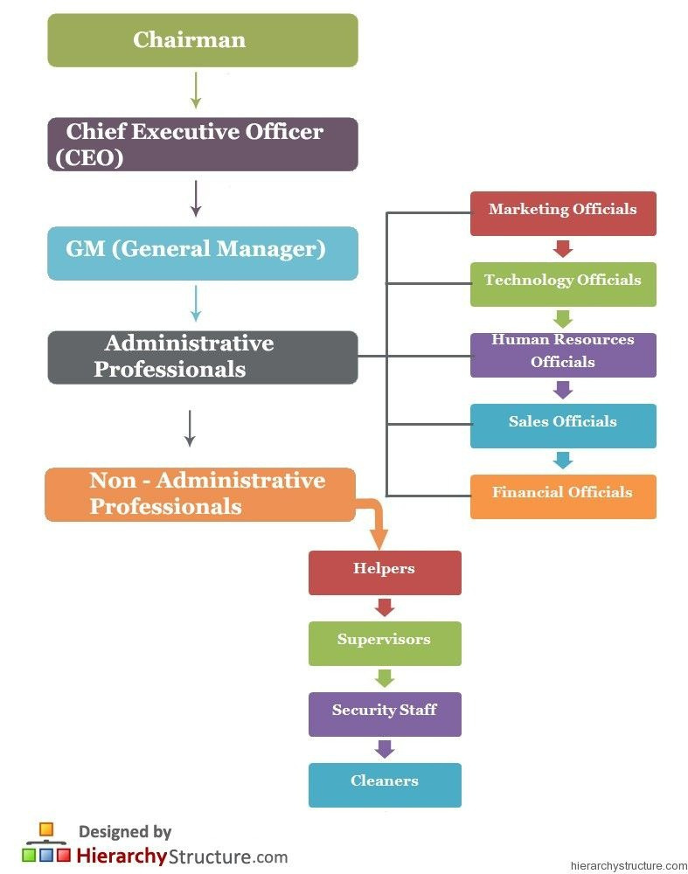
WHO ARE THE END USERS?
6

Slide 7


OUR SOLUTION AND ITS VALUE PROPOSITION
Conditional formatting using =IFS(G10>=1,"applicable",G10>=1,"not applicable",G10=1,"perfect")
7

Slide 8

Dataset Description
1.downloaded employee data set using- kaggle
2.features used:
Emp ID Name
Gender
Department Salary
Start Date
FTE
Employee type Work location
Eligibility

Slide 9

THE "WOW" IN OUR SOLUTION
IFS(G10>=1,"applicable",G10>=1,"not applicable",G10=1,"perfect")
Pivot table,pie chart and bargraph
Highlighting the features
9

Slide 10


MODELLING
1.Dowloaded employee data sheet from kaggle 2.selected 20 datasets in the downloaded data sheet and created a new data sheet 3.Highlighted the features used in the data sheet 4.select the employee performance and done the Eligibility status 5.create the pivot column and created pie chart and bar graph 6.Made analysis using the bargraph
10

Slide 11
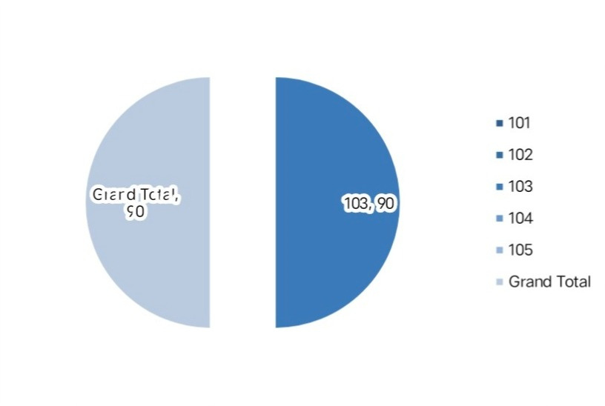
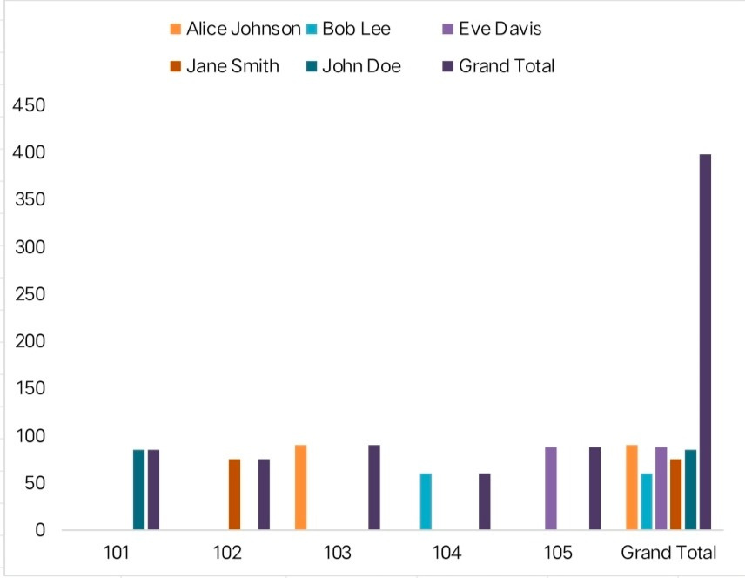
RESULT S
11

Slide 12

conclusion
In conclusion, effective employee performance management is essential for both individual and organizational success. It ensures that employees are meeting expectations, contributing to the company’s goals, and continuously developing their skills. Regular performance evaluations not only drive motivation and productivity but also enable informed decisions regarding promotions, compensation, and career development. Ultimately, a strong focus on employee performance leads to a more engaged, efficient, and successful workforce.

